Slide 1
SPWLA 2026 NMR SIG Conference | Celle, Germany
Author(s) & Affiliation(s)
(For detailed instructions, see slide “Instructions: Title Slide”.

Slide 2
<Enter Slide Title Here; Limit to Single Line; 36 Point, Bold>
This is primary layout; use Calibri font
Use secondary layout for wide content.
Text preferably in bullet form
Use as few words as possible to convey message
Use BOLD for emphasis

Slide 3
Instructions: Title Slide
Author name(s) and affiliations(s):
  Single-affiliation example:
    Jane Smith, Joe Blogs, David Smith; company name
  Multiple-affiliation example:
    Jane Smith¹, Joe Blogs¹, David Smith²;
    ¹company name, ²company name
  Company logo, if used, on title slide only
  Underline the name of the presenter
  Use italic for company name
Use Calibri font

Slide 4
Instructions: Text
When using bullet points; use Calibri font
All slide text must be legible
    (Spellcheck, be concise, use bullets instead of paragraphs, clear legends on graphs and log plots)
Line spacing: 1.5 lines, Indent and Hanging .3
Make sure to space textbox out evenly
Stay consistent with text throughout PPT
Font: Calibri
Font size:
  First-level text: 28-pt recommended, 24 minimum (this is 24 pt)
    Second-level text: 24-pt recommended, 20 minimum (this is 20 pt)

Slide 5
Instructions: Graphics
Graphics (illustrations, plots, etc.) and their text labels must be legible
Font size for graphical test, labels, etc.: 20-pt recommended, 16-pt minimum
Plot axes identified with label and unit
Plots include legend where necessary to understand data
Well-log plots must include track headers (labels, units, and ranges)
Well-log plots should focus or highlight depth interval of interest or event discussed
Use Calibri font

Slide 6
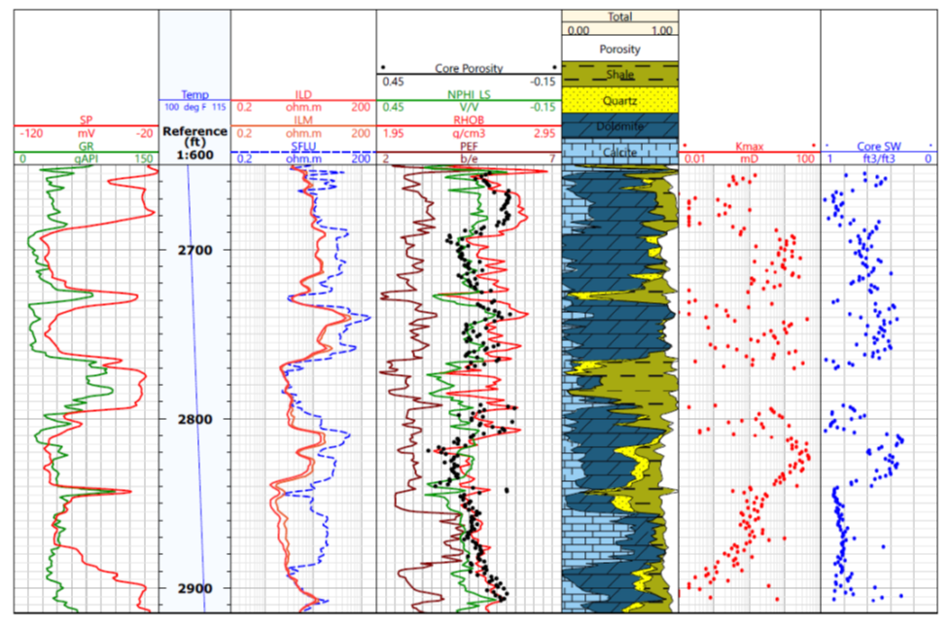
Example of Well Logs: Proper Size and Visibility!
Make sure that your well logs are readable: size and graphical rendering matter!
Multiple clipping of image often deteriorates the image, use original when possible.
(May improve image by double click image and use “Corrections” in upper left.)

Slide 7
Table Color, Size, and Format Samples
Color: Dark Blue | Font: Calibri 24 pt
Font Size: 20 points, Bold
0.43 | 0
Depending on Table Size Font Size 16 or 20, Bold
0.63 | 0
Copy and paste table to your PPT to keep same format colors and fonts, Bold
Color: Dark Blue | Font: Calibri | Font Size: 24 points
Font Style: Calibri | x.xx | 0.21
Font Size: 20 points, Bold | x.xx | 0.32
TEXT-to-Text | x.xx | 0.42
Use Contrasting Colors | 2.3 | 1.7
Dark color for headings recommended for good contrast.
Recommend 24 pt (Min 20 pt) headings
20 pt (Min 16 pt) in tables

Slide 8
Table Color, Size, and Format Samples
Color: Dark Blue | Font: Calibri | Font Size: 24 points
Font Style: Calibri | x.xx | 0.21
Font Size: 20 points | x.xx | 0.32
TEXT-to-Text | x.xx | 0.42
Use Contrasting Colors | 2.3 | 1.7
Cutoffs:
φ <= 0.15
S_{w} >= 0.65
C_{sh} >= 0.50

Slide 9

Sample Image
Image Spacing: Make sure images are spaced evenly, use Calibri font
Text Size:
16 Points; Bold
Legend
Xxxx
Xxxx
Text Size:
16 Points; Bold
Xxxx
Xxxx
Xxxx
Xxxx

Slide 10
Conclusions
Conclusions should be bullet point
Must be concise – to the point

Slide 11
Acknowledgments
As required

